Slide 1
Student Organization International Travel
Tips, Tools and Advice to Help You Prepare
Presented by CIPE, Risk Management and International Compliance
October 8, 2013

Slide 2
Presenters
Katie Bell, CIPE
Kathryn.bell@yale.edu; 2-8761
Michelle Gere, CIPE
Michelle.gere@yale.edu; 2-0800
Marje Lemmon, Risk Management
Marjorie.lemmon@yale.edu; 2-0140
Carolyn Marks, Office of the General Counsel
Carolyn.marks@yale.edu; 6-9049
April Ruiz, CIPE
April.ruiz@yale.edu; 2-8685

Slide 3
Agenda
Risks associated with international travel
Actual cases/situations at Yale
Yale College Student Organizations Manual
Yale Travel Clinic
FrontierMEDEX program
FrontierMEDEX member center
ASIRT
Yale and the World: International Toolkit
Programming and Local Requirements
Environmental Health and Safety Services
Overseas resources
Office of Public Affairs
CIPE, Considering Context, and Personal Responsibility
Resources
Questions

Slide 4
Risks Associated with International Travel
Health and Safety
Political Instability
Transportation/road safety
Vendor/Partner selection
Excursions
Cultural
Personal Decisions
Free Time

Slide 5
Actual Yale Situations—Medical 2011-2012
Description Country
Sprained left wrist Italy
Displaced ankle Hong Kong
Ankle fracture France
Appendicitis Kenya
Viral Illness Vietnam
C spine disc protrusion Italy
Septic shock India
Bug bites France
Heart attack Rwanda
Sepsis/acute renal failure England
Dog bite to face (2 cases) Madagascar
Monkey scratch Laos
Dislocated shoulder Italy
Torn knee tendon France
Urinary tract infection Peru

Slide 6
Actual Yale Situations (non-medical) 2011-2012
Description Country
Prescription assistance Costa Rica
Lost visa Japan
Travel assistance to return home Italy
Security consult Egypt
Earthquake/Possible Nuclear issue Japan

Slide 7
Yale College Student Organizations Domestic and International Travel
http://yalecollege.yale.edu/content/domestic-and-international-travel
Student Groups Trip Leader Handbook

Slide 8
Travel Clinic
http://yalehealth.yale.edu/travel
Provides comprehensive consultation, education, vaccinations and travel medications
Fee for service
Reduced per person fee for group consults
Plan ahead and book ahead!

Slide 9
FrontierMEDEX
International and Domestic Assistance
Medical, security and natural disaster
Evacuation services
Assistance/guidance
Travel arrangements
Coverage is automatic
Not Health Insurance
http://ogc.yale.edu/FrontierMEDEX_Program
Contains links to:
Complete program description guide
.pdf of membership card
Sublink to custom Yale/FrontierMEDEX member center

Slide 10
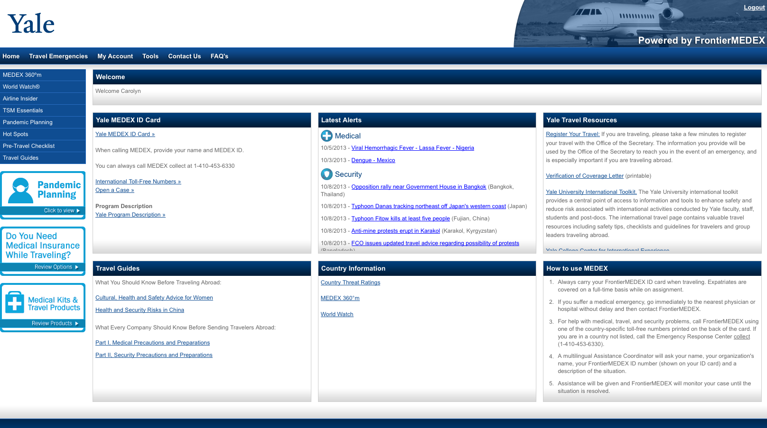
FrontierMEDEX Member Center
FrontierMEDEX member center

Slide 11
ASIRT
Non-profit organization promoting global road safety
Works to improve road safety and to improve traveler’s knowledge of road safety
www.asirt.org

Slide 12
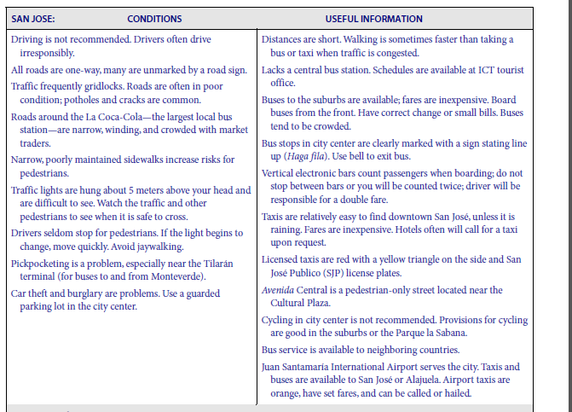
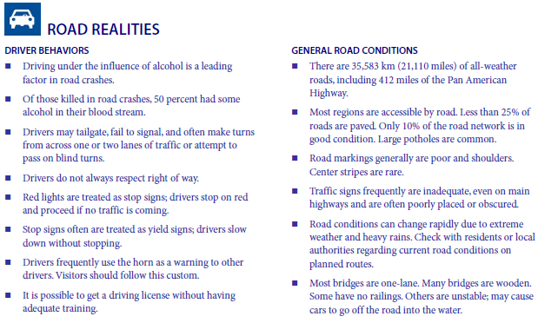
ASIRT Road Travel Report

Slide 13
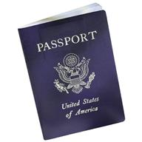
Yale’s International Toolkit http://world-toolkit.yale.edu
Travel Tips and Resources
Yale Travel Management
CIBT (visa services)
CIPE
Yale Travel Clinic
FrontierMEDEX
Yale Travel Registry
Country Resources
Research Overseas

Slide 14
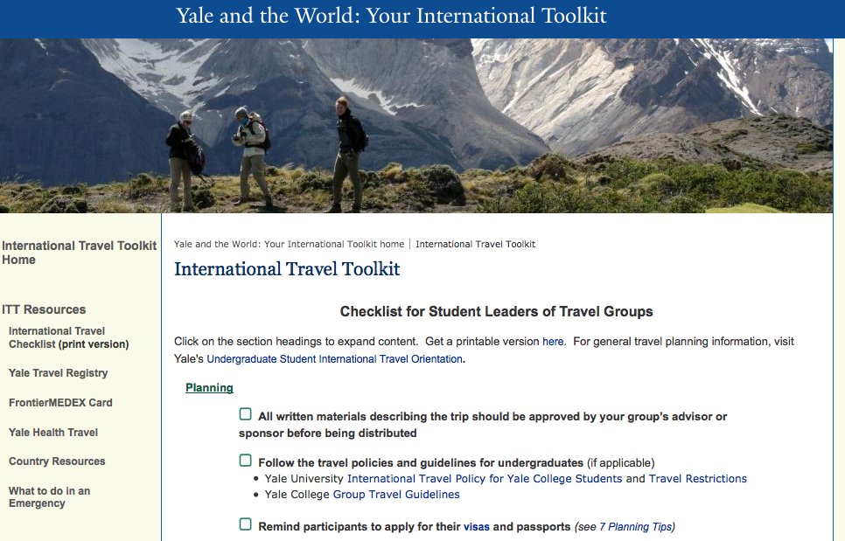
International Travel Toolkits
Travel group leader checklists and resources
Student traveler orientations
http://world-toolkit.yale.edu/orientations

Slide 15
Programming and Local Requirements
Traveling with electronic devices
Export/import restrictions (U.S. and foreign)
Data privacy and protection
EU’s comprehensive data privacy laws
Service trips
Observe local laws
Obtain necessary licenses, permits
Work with local partners
Country and individual/entity restrictions
For more information
International Toolkit http://world-toolkit.yale.edu/restrictions_overview
For help, contact Office of General Counsel
203-432-4949 or http://ogc.yale.edu

Slide 16
Environmental Health and Safety Services
Some activities may present special health and safety risks
Patient contact
Laboratory activities
Contact with animals
Yale’s office of Environmental Health and Safety can help you prepare
Conducts specialized training
Can provide personal protective equipment
Contact benjamin.fontes@yale.edu or ehs@yale.edu or 785-3550 for more information

Slide 17
Overseas Resources
Yale has contacts and connections all over the world
Good source of information and advice regarding your destination
May be of assistance in times of emergencies
Contact alisa.masterson@yale.edu
Assistant Director for University Relations AYA

Slide 18
OPA Connections—Get Press!
Office of Public Affairs is interested in where you are going and what you are doing
Contact shana.schneider@yale.edu
Director of Communications

Slide 19
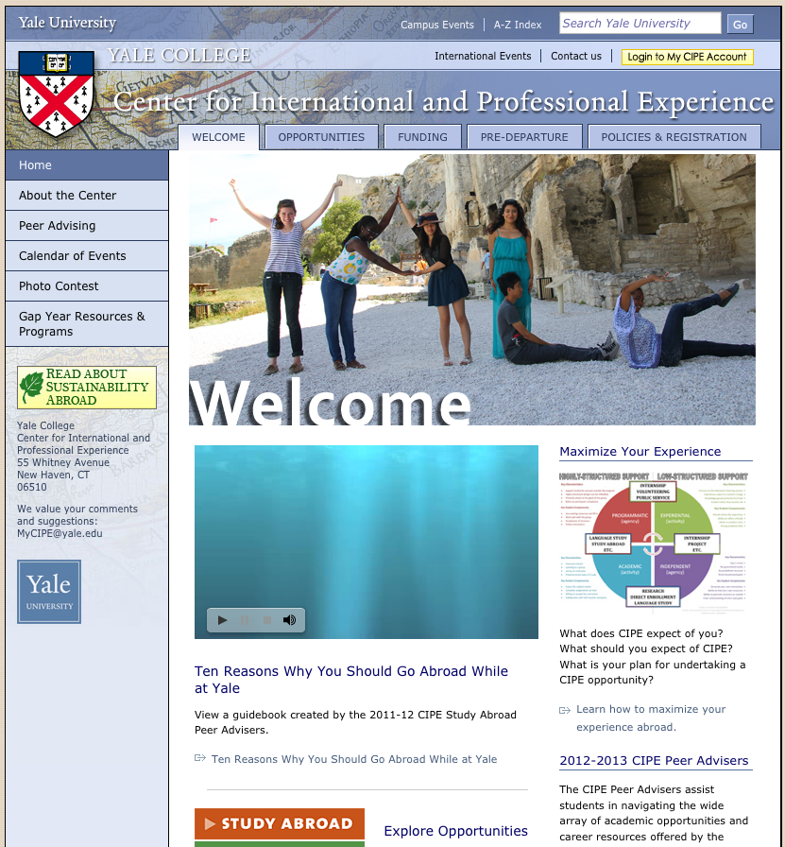
Center for International and Professional Experience (CIPE)
Use CIPE as a resource
Undergraduate Travel Policy: http://www.yale.edu/yalecollege/international/travel/policy.html
AYA and connecting with alumni

Slide 20
Personal Responsibility
Identity & Diversity
Learn about your destination
Cultural sensitivity vs. personal boundaries
Your Health
Pre-existing health conditions
Sexual Health
Local health services & insurance
Alcohol & Other Drugs
Laws, customs, personal choices
Strategies for staying safe
Lifestyle choices
Cultural and political environment
Have a plan
Group plan
Individual plan

Slide 21
Considering context
Respect. Respect. Respect.
Manage your expectations.
You will learn more than you contribute (and that’s okay!)
Respond to need, but don’t act without training.
Put yourself in others’ shoes.
Be thankful.

Slide 22
Considering context
from First, Do No Harm full documentary available at: http://vimeo.com/22008886

Slide 23
Considering context
from First, Do No Harm full documentary available at: http://vimeo.com/22008886

Slide 24
Resources
CIPE
International Toolkit
FrontierMEDEX
Yale Travel Registry
Yale College Travel Policy
Yale College Undergraduate Organizations Travel Policy
Trip Leader Handbook
Yale HEALTH Travel Clinic
EHS field work abroad
EHS Traveling Abroad
EHS supply request

Slide 25
Questions?

